Slide 1
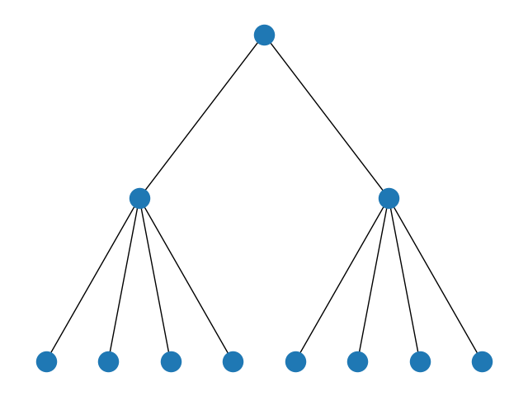
Exponential Search Trees
Group Members:
Muhammad Talha
Ali Hashir
Ibrahim Ali
Laiba Jamil
Mustafa Usman

Slide 2
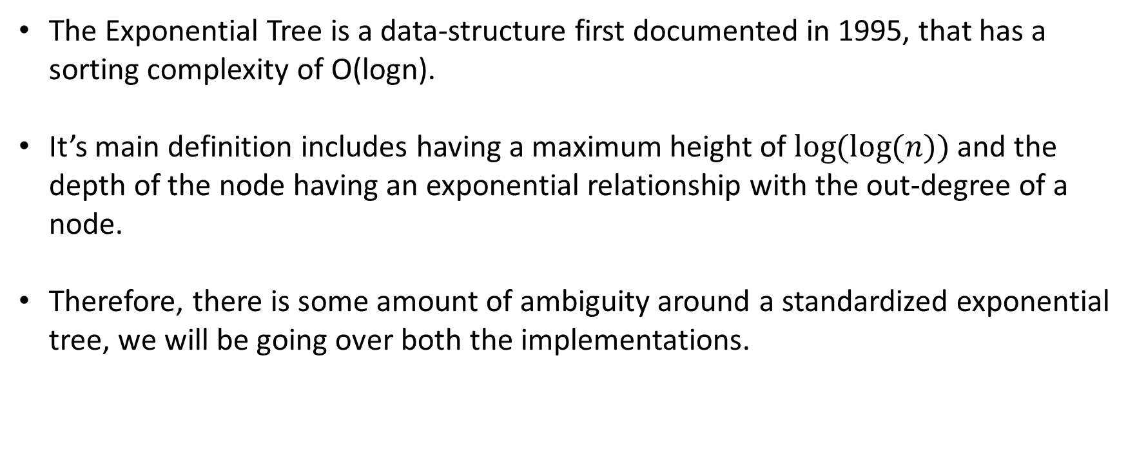
Understanding the Exponential Tree
The Exponential Tree is a data-structure first documented in 1995, that has a sorting complexity of O(logn).
It’s main definition includes having a maximum height of $\log{(log⁡(n))}$and the depth of the node having an exponential relationship with the out-degree of a node.
Therefore, there is some amount of ambiguity around a standardized exponential tree, we will be going over both the implementations.

Slide 3
The M-Way Approach
Ibrahim ---

Slide 4
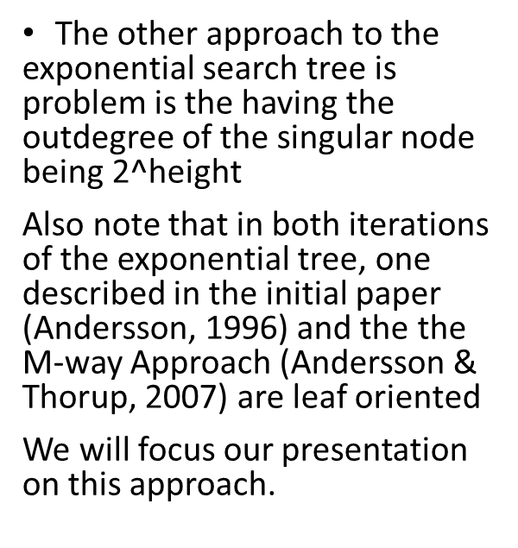
The Other Approach
The other approach to the exponential search tree is problem is the having the outdegree of the singular node being$\text{2^}\text{height}$
Also note that in both iterations of the exponential tree, one described in the initial paper (Andersson, 1996) and the the M-way Approach (Andersson & Thorup, 2007) are leaf oriented
We will focus our presentation on this approach.

Slide 5
Time Complexity

Slide 6
Asymptomatic Complexity
Operation | Complexity (Big O)
Searching | Log (n)
Insertion | max (n-i,i) ~ n
Deletion | Constant

Slide 7
Amortized Analysis
Operation | Best Case | Worst Case
Add |  | Log(log(n))
Search | O(log(n)) | Log(log(n))
Delete |  | Log(log(n))

Slide 8
Main functionalities w.r.t Worst and Best possible
Insert (X, x)
Delete (X, x)
Search (X, y)
Minimum/Maximum (X)
All of the following operations can be implemented in O(log n) time for comparison-only keys and O(log(n))^1/2. Best possible
For lexicographically ordered data types, exponential search trees, can support all the above operations in O(log log n) worst-case time, and this common bound is best possible

Slide 9
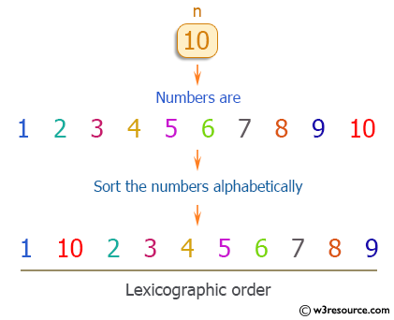
lexicographically ordered data types?
Lexicographical order is nothing but the dictionary order.
generalization of the alphabetical order of the dictionaries to sequences of ordered symbols or, more generally, of elements of a totally ordered set.
For example, let's take three strings, "short", "shorthand" and "small". In the dictionary, "short" comes before "shorthand" and "shorthand" comes before "small".

Slide 10
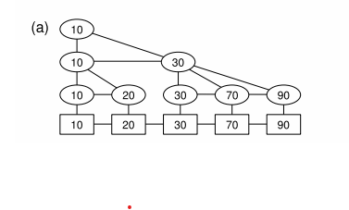
Lexicographically ordered Exponential Tree

Slide 11
Proving the Max Height
We know that it is one of the definitions of the Exponential Search Tree to have log(log(n)) height
N=8
Log2(8)=3
Log2(3)=1.585 ~ 2

Slide 12
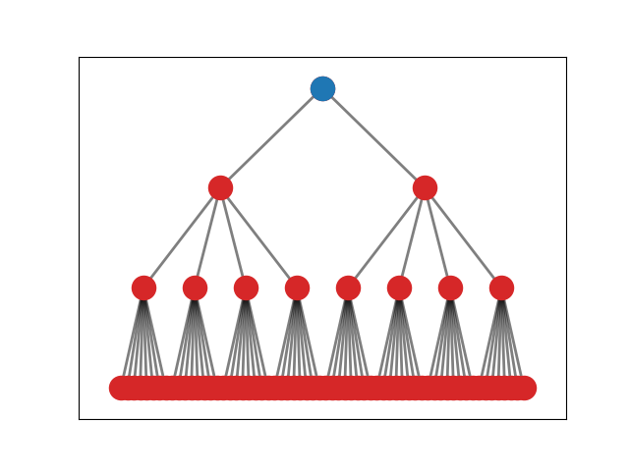
Proving the max height
Height=3
N=64

Slide 13
Demerits
Novel Approach – Hardly Used
Bad Average Case Optimal Bound
Costly Resizing/Insertion

Slide 14
Use-Case
Same case as Red-Black Trees and AVL, this data structure can be deployed where insertion and deletion are low
Insertion also brings cost of n or n-I shifts
Data that does not increase dramatically in size
Can be used to store ordered data.
Can be used at
Library management system.
Website Archives
A Point Of Sale system for a failing business

Slide 15

Merits
Log(n) Searching Time Complexity
Good for search-intensive applications
Currently Best-Case Optimal Bound
Max Height = $log⁡(\log\left(n\right))$

Slide 16
Why exponential tree?
Time taken for searching and insertion using exponential search trees (worst case) = O(sqrt(log n/ log logn)) and the height is O(log log n) which is otherwise O(log n) in case of bst, avl, etc.
How?
Modification:
Search (X, y) Returns a pointer to the largest key in X which is smaller than or equal to y, or null if y is smaller than any key in X

Slide 17
Suitability
Dynamic Ordered Sets – Basic Operations starting from an empty set X
Insert (X, x) Add x to X where x is a pointer to a key.
Delete (X, x) Remove x from X, here x is a pointer to a key in X.
Search (X, y) Returns a pointer to a key in X with the same value as y, or return a null pointer if there is no such key in X.
Predecessor/Successor (X, x) Given that x points at a key in X, return a pointer to the next smaller/larger key in X (or a null pointer if no such key exists).
Minimum/Maximum (X) Return a pointer to the smallest/largest key in X (or a null pointer if X is empty).

Slide 18
Similar Data Structures
Main Use Case Efficient Searching and storing sorted data
BST
AVL
Red Black Trees
SkipList
In terms of Optimal Bound
Fusion Trees

Slide 19
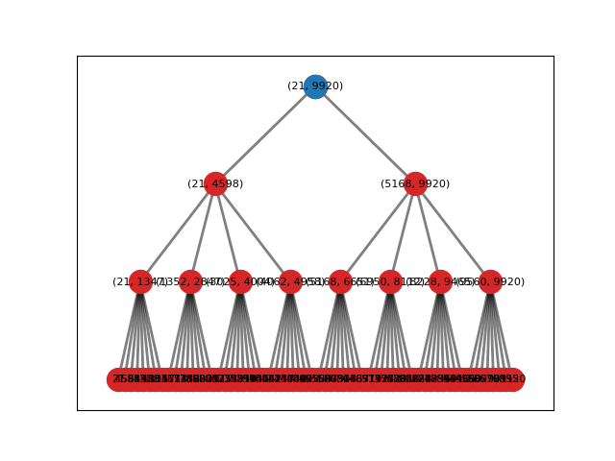
Searching
Let’s imagine we want to search for the number 1500

Slide 20
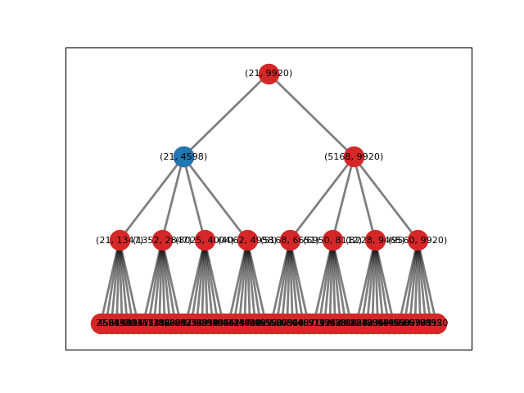
Searching
Value is less than 4598

Slide 21
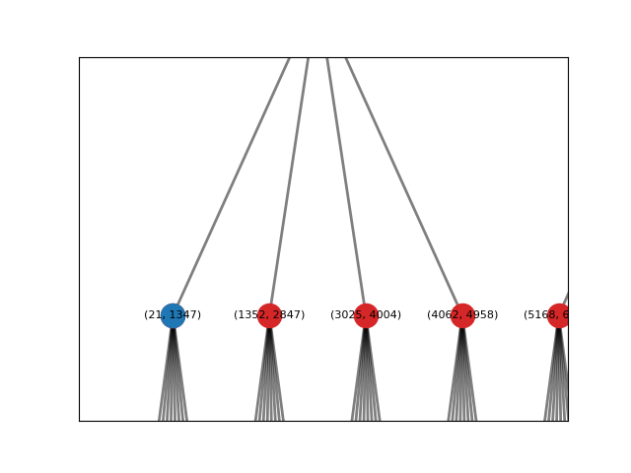
Searching
Value is more than 1347

Slide 22
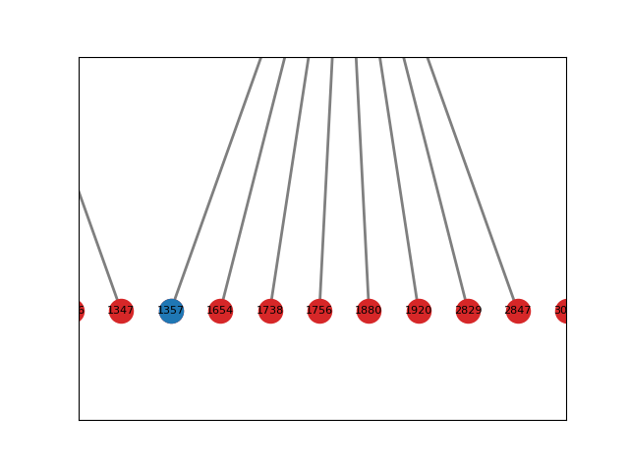
Searching
Value is between 1352 and 2847

Slide 23
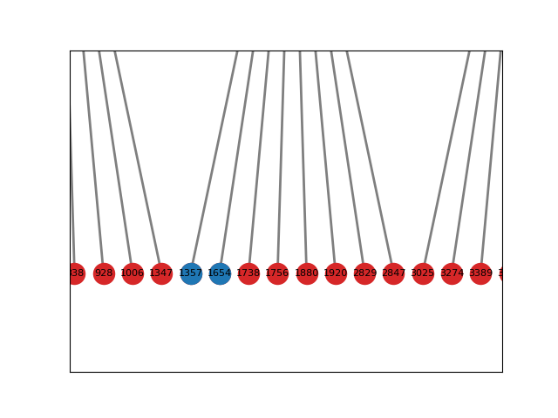
Searching
Value is greater than 1352 and
Smaller than 1654
The value does not exist.

Slide 24
Insertion
Duplicates are allowed, save for the application constraints
Calls Search Function Helpful Tip: Think of the
If tree is not full
shift one to the right until free space is found.
Adjust range tuples according in parent nodes
Else
--Resize
--Add Extra Height, divide the current load as leaf nodes become internal nodes.
-- Resize-Balancing is not discussed in the paper.

Slide 25
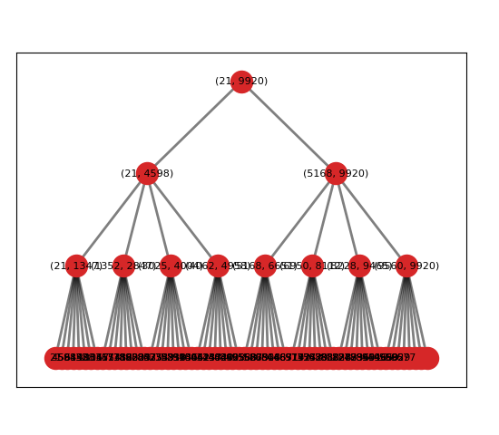
Insertion Case 1
We know if that there are values in the tree that are less than the values it can hold. There will be empty spaces to the right. Add your value to the tree by searching and then shift to the right.

Slide 26
Insertion Case 1
Lets insert 43

Slide 27
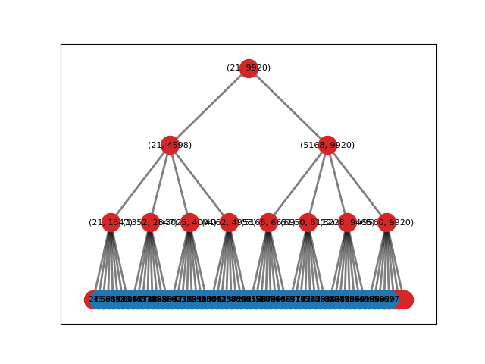
Insertion Case 1

Slide 28
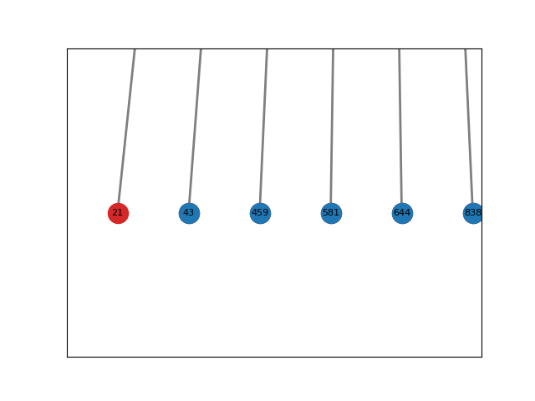
Insertion Case 1

Slide 29
Deletion
The Deletion Algorithm has not defined properly because of lack of balancing in the initial paper.
Our assumption : Call the search function
If found
delete
shift all values in parent_node to left
replace empty nodes with terminating
character
Else ignore
Check for load_factor, max values it can hold vs
Values current stored. If below minimum load, shrink

Slide 30

Thank You
Github Repo : https://github.com/Talha771/DS2Project

